Slide 1
Truss Submittal Packages and Jobsite Packages
Overview
Revised 4/6/2017

Slide 2
SBCA has been the voice of the structural building components industry since 1983, providing educational programs and technical information, disseminating industry news, and facilitating networking opportunities for manufacturers of roof trusses, wall panels and floor trusses. SBCA endeavors to expand component manufacturers’ market share and enhance the professionalism of the component manufacturing industry.
Copyright © 2017 Structural Building Components Association.

Slide 3

Introduction
Property damage, serious bodily injury and/or death are possible if the Contractor fails to properly handle, install, restrain and brace trusses.
This presentation reviews what is required by building codes and industry standards regarding Truss Submittal Packages and Jobsite Packages

Slide 4
Background
The IBC and IRC contain code requirements regarding Truss Submittal Packages, truss submittals, and truss bracing.
Truss Submittal Packages:
  2303.4.1.4.1 Truss design drawings (Wood)
  2303.4.2 Truss placement diagram (Wood)
  2303.4.3 Truss submittal Package (Wood)
  2211.3.1 Truss design drawings. (Cold-formed steel)
Truss Submittals
  R502.11.1 Design.
  R502.11.4 Truss design drawings.
  R802.10.1 Truss design drawings.
  R802.10.2 Design.
Truss Bracing
  R106.1.2 Manufacturer’s installation instructions
  R502.11.2 Bracing.
  R802.10.3 Bracing.

Slide 5
Background
ANSI/TPI 1 is a standard referenced by both the IBC and IRC governing metal plate connected wood trusses that:
  Establishes minimum requirements for design and construction
  Defines the accepted responsibilities for all parties involved
One of the Truss Manufacturer’s responsibilities, as defined in ANSI/TPI-1-2014, is to supply the Truss Submittal Package to the contractor
2.3.6.5 Required Documents.
2.3.3 Requirements for the Permanent Member Restraint/Bracing of Truss Systems.
2.3.3.1 Method of Restraint.
2.3.3.1.1 Standard Industry Details.
2.3.3.1.2 Substitution with Reinforcement.
2.3.3.1.3 Project Specific Design.
2.3.3.2 Absence of Truss Restraint/Bracing Method or Details.
2.3.3.3 Trusses Spanning 60 Feet (18 m) or Greater.
2.3.6.7 Truss Submittal Packages.
2.3.4.2. Information Provided to the Building De­signer.
2.3.4.3 Truss Submittal Package Review.

Slide 6
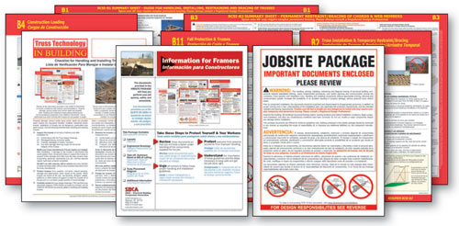
Background
A Jobsite Package is a collection of documents sent by the truss manufacturer along with the truss delivery to promote safe installation practices
Although the IBC and ANSI/TPI 1 are open to many possible methods of delivering this information, both reference BCSI as an industry standard for handling, installing, restraining and bracing trusses

Slide 7
Background
If correctly implemented, the information contained in BCSI helps to ensure consistent jobsite safety and acceptable structural performance.
BCSI includes simple, safe and proven methods that are consistent with accepted framing construction practices.

Slide 8
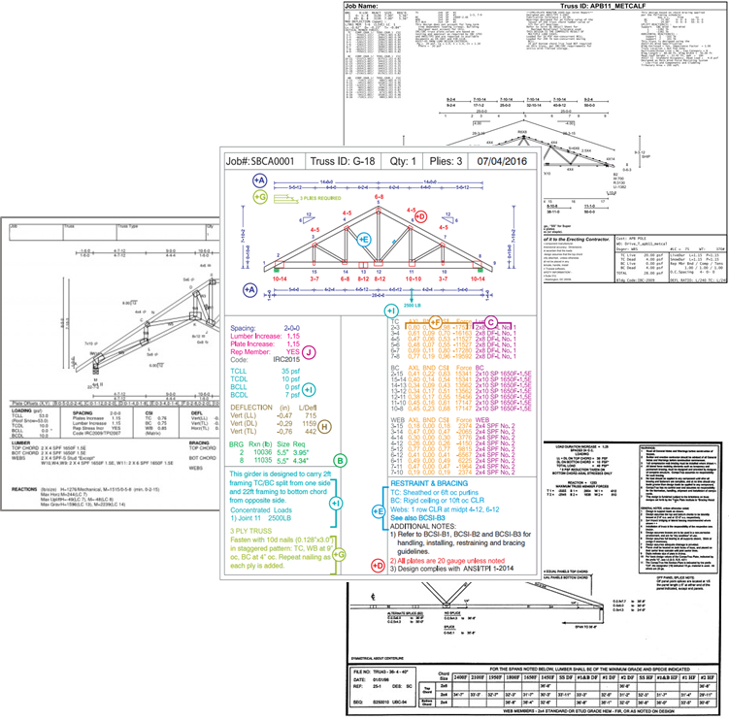
Application
Truss Submittal Packages should include:
  Individual Truss Design Drawings (TDD)
  Truss Placement Plan (TPP)
  Individual Truss Member Restraint/Bracing Locations (if required)
  Jobsite Package
    For Sloped Roof Trusses: BCSI-B1 and BCSI-B3 Summary Sheets
    For Floor and Flat Roof Trusses: BCSI-B1 and BCSI-B7 Summary Sheets
    Additional Pertinent Information (i.e. hanger installation guides, LVL details, etc.)

Slide 9
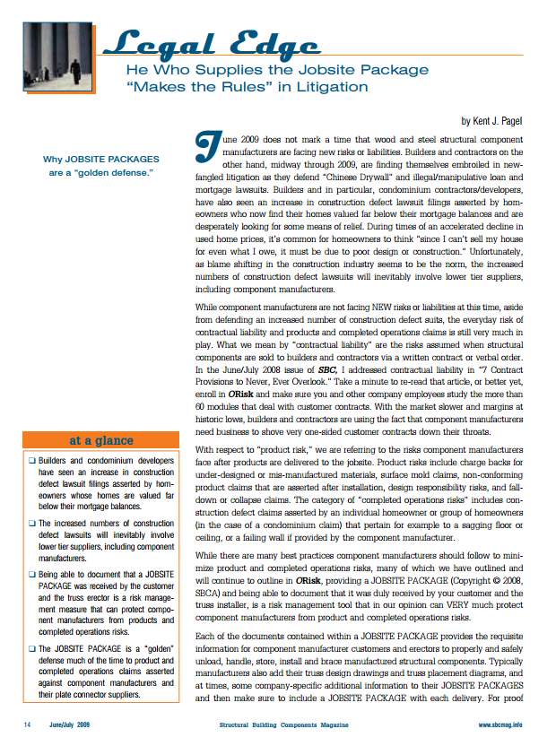
Application
Including the Jobsite Package in the Truss Submittal Package with each truss delivery not only fulfills the truss manufacturer’s duty to provide information for builders, it can protect the manufacturer legally.
SBCA’s legal counsel Kent Pagel provides the concepts behind this recommendation in his Structural Building Components (SBC) Magazine article entitled “Legal Edge: He Who Supplies the Jobsite Package ‘Makes the Rules’ in Litigation” (June/July 2009)
  Some component manufacturers include a charge for the jobsite package, to prove that the manufacturer fulfilled their duty to educate and warn while providing customers with key installation and safety information.

Slide 10
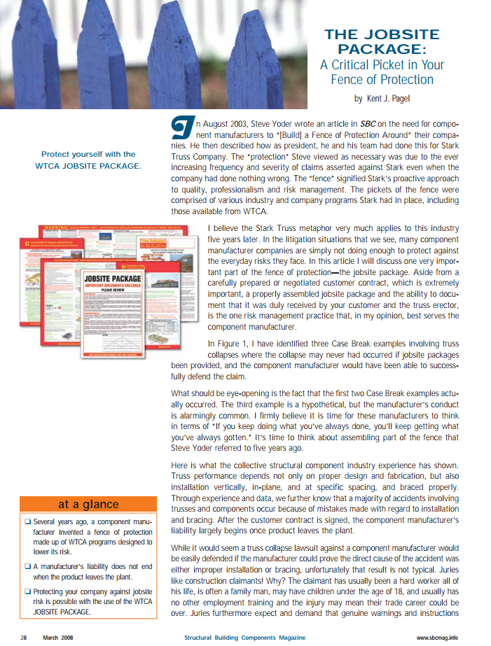
Application
Another SBC Magazine article “The Jobsite Package: A Critical Picket in Your Fence of Protection” (March 2008) gives further reasons why it is in the manufacturer’s best interest to provide a Jobsite Package:
  Prevent potential truss collapse
  Provide helpful information geared to builders and erectors
  Practice good risk management by conforming to industry-based guidelines and documentation
  Acting proactively to warn, instruct and educate can help prevent disputes, including legal disputes

Slide 11
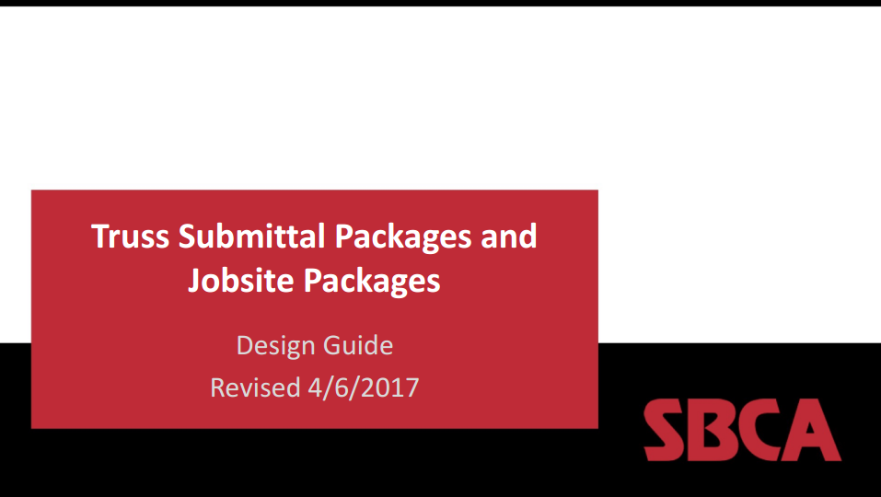
Conclusion
A Truss Submittal Package, including a Jobsite Package, should be sent to the job site with each truss delivery
SBCA’s Jobsite Package offers best practice information in a standard format to meet building code requirements, increase safety, and ensure truss manufacturers responsibilities are satisfied.
See DrJ Design Guide for detailed information on selecting a Jobsite Package

Slide 12
References
SBCA, Guide to Good Practice for Handling, Installing, Restraining & Bracing of Metal Plate Connected Wood Trusses (BCSI). Structural Building Components Association.
CFSC, Guide to Good Practice for Handling, Installing, Restraining & Bracing of Cold-Formed Steel Trusses (CFSBCSI). Structural Building Components Association.
Structural Building Components Magazine, “Legal Edge: He Who Supplies the Jobsite Package ‘Makes the Rules’ in Litigation” (June/July 2009). Truss Publications, Inc.
Structural Building Components Magazine, “The Jobsite Package: A Critical Picket in Your Fence of Protection” (March 2008).
Truss Plate Institute, National Design Standard for Metal Plate Connected Wood Trusses (ANSI/TPI 1), 2007/2014.
International Code Council (ICC), International Building Code (IBC), 2009, 2012 and 2015 editions.
International Code Council (ICC), International Residential Code (IRC), 2009, 2012 and 2015 editions.

