Slide 1
Use of Cantilevered Sill Plates with MPCWT to Align with Varying Thicknesses of Exterior Sheathing
Overview
Revised 3/22/2017

Slide 2
SBCA has been the voice of the structural building components industry since 1983, providing educational programs and technical information, disseminating industry news, and facilitating networking opportunities for manufacturers of roof trusses, wall panels and floor trusses. SBCA endeavors to expand component manufacturers’ market share and enhance the professionalism of the component manufacturing industry.
Copyright © 2017 Structural Building Components Association.

Slide 3
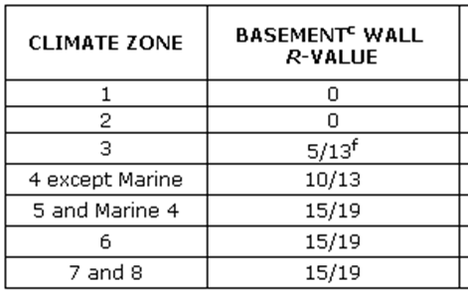
Introduction
The prescriptive residential energy code requirements found in the 2009, 2012 and 2015 International Residential Code (IRC) include requirements for continuous insulation at foundations (Table N1102.1) in several climate zones.

Slide 4
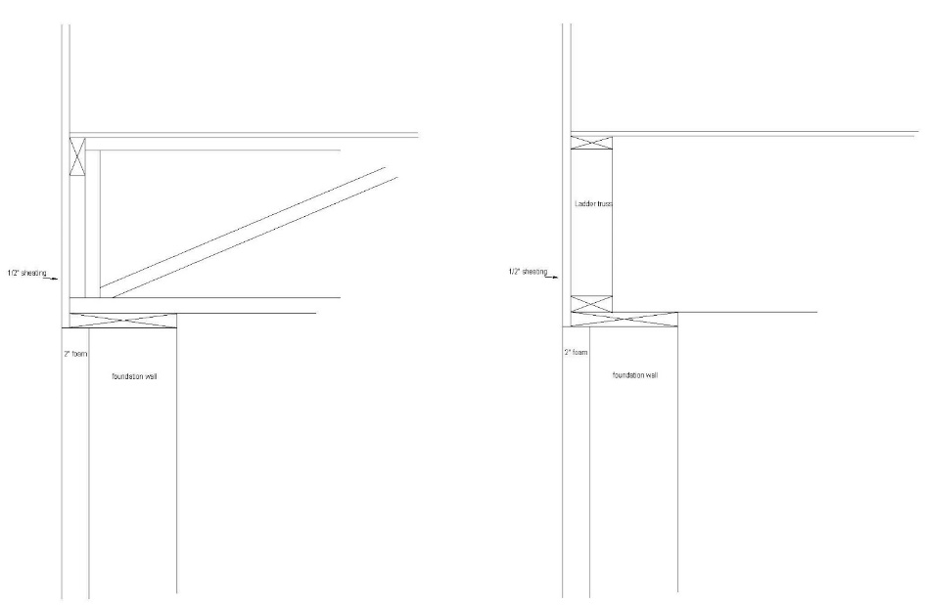
Introduction
This presentation discusses the issue of cantilevered sill plates supporting metal plate connected wood trusses (MPCWT) installed parallel and perpendicular to the foundation walls where there is a potential for discontinuous planes between the exterior wall above the sill plate and the foundation insulation planes.
Truss installed perpendicular to foundation wall
Truss installed parallel to foundation wall

Slide 5
Introduction
Assumptions:
  Exterior wall sheathing is any thickness to align the exterior face of the sheathing with the exterior face of the sheathing below.
  Basement continuous insulation is installed on the exterior of the foundation and does not exceed 2".
  Floor system is bottom chord bearing metal plate connected wood trusses.
  The sill plate does not overhang the foundation by more than 1⁹/₁₆".

Slide 6
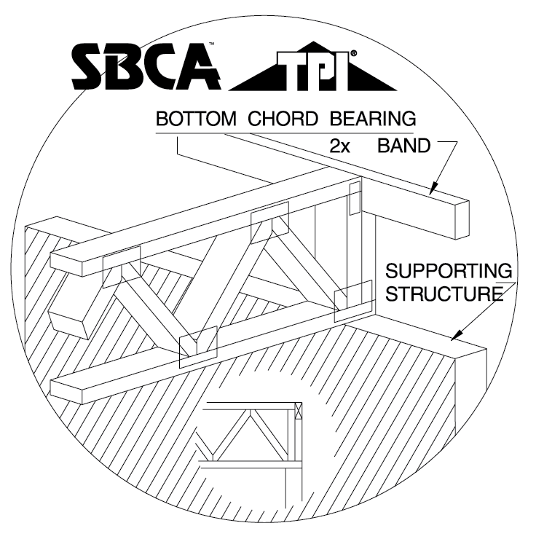
Key Definitions
Band, Rim or Header Joist – Not defined, but shown on IRC Figure R502.2. In the case of sawn lumber and I-joists, it is a full depth framing member that provides lateral support for the ends of the joists perpendicular to the foundation.
Bottom Chord Bearing – (BCSI) Bearing condition of a truss that is supported on its bottom chord.

Slide 7
Key Definitions
Continuous Insulation – (IRC Chapter 2) Insulating material that is continuous across all structural members without thermal bridges other than fasteners and service openings. It is installed on the interior or exterior or is integral to any opaque surface of the building envelope.
Ribbon (Band) – (BCSI) Framing member installed on the edge of the exterior perimeter, usually tying the ends of the floor trusses together. Note: structural sheathing, blocking panels, or a rim board may be required, in addition to the ribbon, to transfer all the lateral loads (see BCSI–B7).
Sill Plate – Not defined, but shown in IRC Figure R502.2. It is attached to the foundation using anchor bolts and the floor system is, in turn, attached to the sill plate.

Slide 8
Background
The IRC includes prescriptive information regarding floor cantilevers for sawn lumber (R502.3.3).
The IRC also provides prescriptive information on lateral restraint at supports for sawn lumber (R502.7) but defers to the manufacturer’s recommendations for engineered products in Exception 1.
  Trusses, structural composite lumber, structural glued-laminated members and I-joists shall be supported laterally as required by the manufacturer’s recommendations.

Slide 9
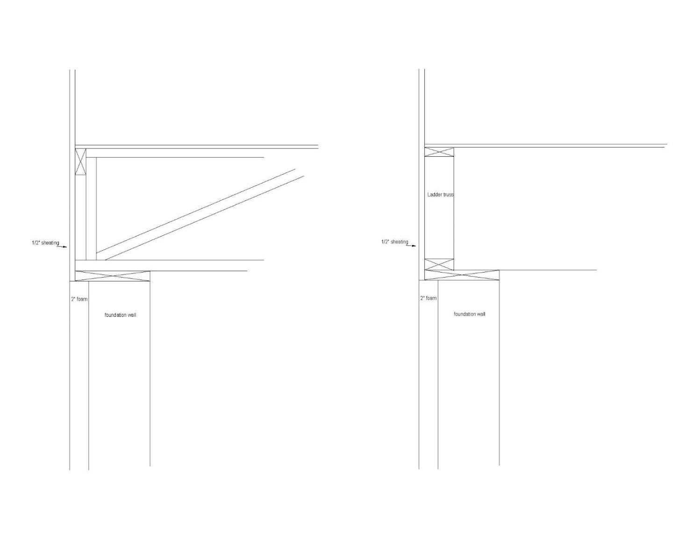
Discussion
Where the floor truss runs perpendicular to the foundation, it carries the load of the roof, walls, and any upper floors and transmits the load to the sill plate through the two vertical members that form the end of the floor truss (notched to accommodate the ribbon).

Slide 10
Discussion
With a maximum 1-⁹/₁₆" cantilever, one of the two verticals bears on the bottom chord and sill plate over the foundation.
The truss plate connecting the end verticals to the truss bottom chord will assist in transferring load into the truss bottom chord.

Slide 11
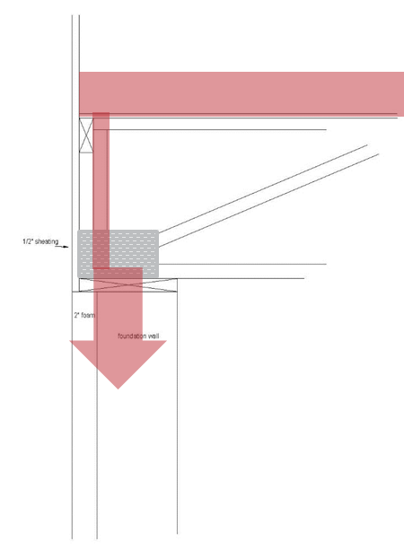
Discussion
Two general engineering principles apply to this situation.
  First, loads flow to the stiffest members.
    Since the foundation is the stiffest location, it will attract the load.
  Second, loads follow a load path through solid materials at up to a 45° angle from the point of loading.

Slide 12
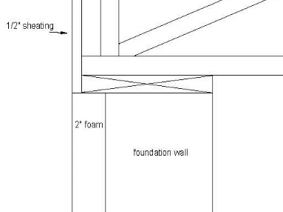
Discussion
In addition, a general “rule-of-thumb” formula allows a sill overhang of ½ the plate thickness.
In this case, the bottom chord of the truss and the sill plate equals 3", allowing up to a 1-¹/₂" cantilever using this rule of thumb.

Slide 13

Discussion
Where the floor truss runs parallel to the foundation (typically on a gable end), it is typically more lightly loaded.
With a maximum 1-⁹/₁₆" cantilever of the sill plate in this condition, the ladder truss is 3-¹/₂" wide, so 2" bears on the sill plate over the foundation.

Slide 14
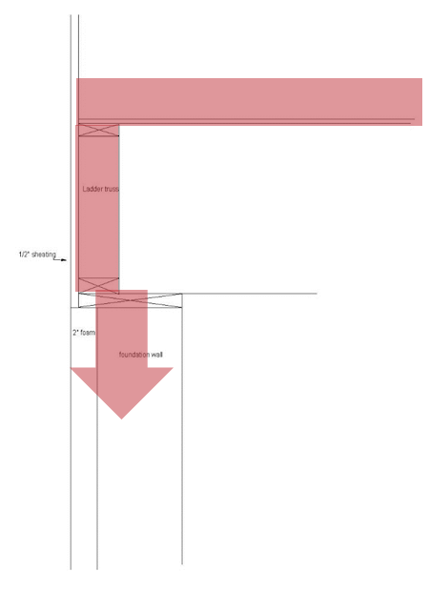
Discussion
The stiffness of the foundation attracts the load, and the load is distributed through the bottom chord and sill plate at a 45° angle.
The rule-of-thumb returns the same result.
This situation also does not require any special truss design.

Slide 15
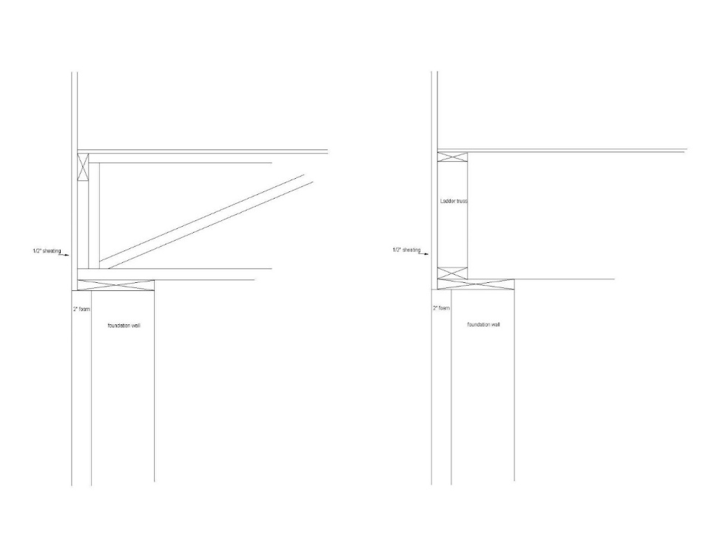
Discussion
Truss to sill plate and sill plate to foundation connections are required.
Consult the locally adopted building code for connection requirements.

Slide 16
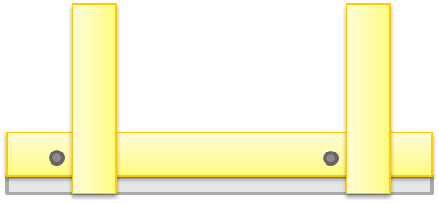
Discussion
The truss-sill plate connection should be as close as practical to the line of sill plate anchor bolts to prevent parallel to grain bending in the sill plate when loaded in uplift.
One of the primary purposes of this connection is to resist uplift on the trusses from the walls above.
No additional consideration is required due to the cantilever.

Slide 17
Findings
Sill plates supporting metal plate connected wood truss floor systems as described in this presentation may be cantilevered up to 1-9/16" without requiring design of the trusses for a cantilevered condition.
Truss to sill plate uplift connections, where required, are made per the applicable building code for the non-cantilevered condition.
No additional design for the connection is required.
In all cases, consult the local building code for sill plate to foundation and floor system to sill plate connection requirements.

Slide 18
References
International Residential Code (IRC), International Code Council.
Building Component Safety Information (BCSI), Structural Building Components Association (SBCA) and the Truss Plate Institute (TPI).

