Slide 1
Overdriven Nails in Structural Sheathings
Overview
Revised 3/22/2017

Slide 2
SBCA has been the voice of the structural building components industry since 1983, providing educational programs and technical information, disseminating industry news, and facilitating networking opportunities for manufacturers of roof trusses, wall panels and floor trusses. SBCA endeavors to expand component manufacturers’ market share and enhance the professionalism of the component manufacturing industry.
Copyright © 2017 Structural Building Components Association.

Slide 3

Introduction
All building codes provide provisions for the attachment of structural sheathing to wall and roof framing members.
Structural sheathing connections to building framing are important for lateral shear resistance, or the ability of a building to resist wind and seismic loads.

Slide 4
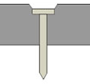
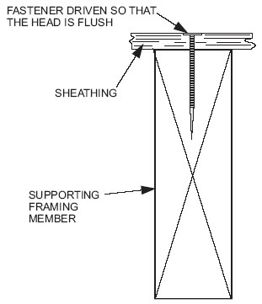
Introduction
When designing attachment for structural sheathing, designers rely upon published data – whether from the building codes, referenced standards, or proprietary sources
In almost every case, the published values assume the head of the fastener is flush with the surface of the sheathing, NOT embedded beneath the surface (overdriven)
Overdriven fasteners reduce the shear strength of the sheathing by reducing the effective thickness of the panel, which then may not be able to resist the intended loads.
Overdriven
Correct

Slide 5
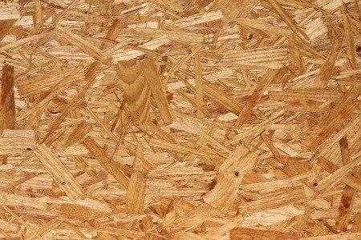
Introduction
At panel edges, overdriven fasteners allow for easier pull-through or tear-out due to the reduced thickness of the panel at the fastener head.
At intermediate framing members, overdriven fasteners provide reduced resistance to panel buckling.

Slide 6

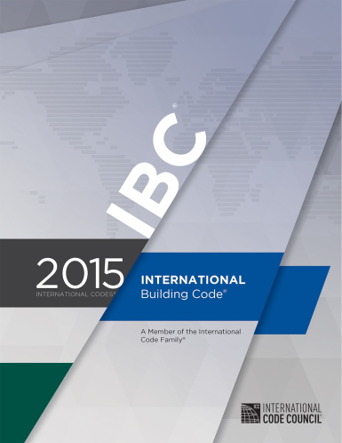
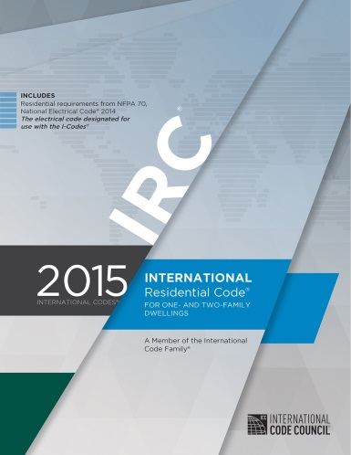
Introduction
There is no guidance in the International Building Code (IBC), International Building Code (IRC), or National Design Specification for Wood Construction (NDS) as to what the capacity reduction is for overdriven fasteners, nor what corrective action could be taken.
This presentation will provide guidance on how to ensure shear capacity in cases with overdriven fasteners

Slide 7
Background
The IBC only describes how sheathing fasteners should be installed, but not how to resolve situations where fasteners have been installed improperly.
This same requirement is not included in the IRC.
2304.9.2 Sheathing fasteners. Sheathing nails or other approved sheathing connectors shall be driven so that their head or crown is flush with the surface of the sheathing.

Slide 8
Background
However, since the prescriptive requirements are based on testing or calculations that assume the fasteners are driven flush with the surface of the sheathing, it is still necessary to achieve the intended function of the prescriptive requirements.
Regardless of code requirements for the sheathing fastener (spacing, diameter, length, etc.), the fastener must be driven flush with the sheathing surface to achieve the intended capacity of the wall system.

Slide 9
Analysis – NDS
The 2015 NDS does not address the issue of over-driven nails but does offer design values for dowel-type fasteners in Chapter 12.
These design values are calculated assuming fasteners are installed correctly.

Slide 10

Analysis – IBC
The 2009 and 2012 IBC Commentary for Section 2304.9.2 provide the following information regarding overdriven fasteners:
  This requirement is a matter of workmanship (see Figure 2304.9.2 for an illustration of a nail driven to fasten sheathing properly). Protruding nails do not provide the intended connecting capacity and could be hazardous. Likewise, nails overdriven into structural sheathing may not perform as expected. Framing installation is often less than perfect and fasteners are overdriven to a point where the top layer of sheathing is crushed beneath the nail head. An occasional overdriven nail may not be significant. As the percentage of overdriven fasteners increases, the issue raised is at what point does this adversely affect the shear capacity of a diaphragm or shear wall element. The APA has recognized that this is a common occurrence and has made a guideline available at no cost on its website (www.apawood.org). Another condition to be aware of in sheathing nailing is where the depth of the supporting member is less than the length of a commonly used fastener, such as in a case where sheathing will be applied over the top of flat decking. Shorter nails are available for these situations, but the holding and shear capacities are typically reduced.

Slide 11
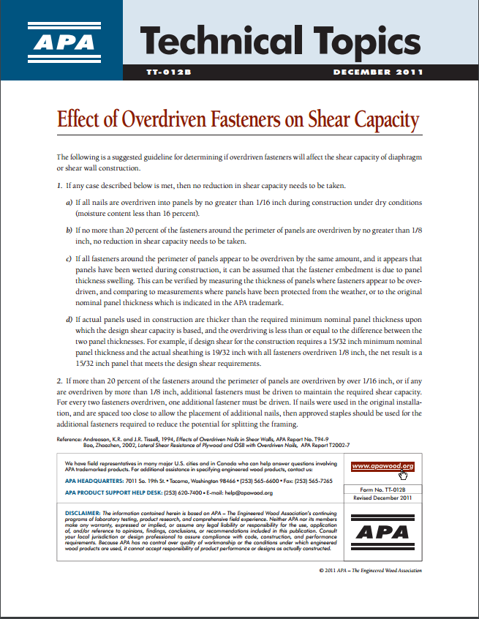
Analysis – Engineered Wood Association (APA)
Technical Topics: Form TT‑012B, Effects of Overdriven Fasteners on Shear Capacity offers the following guidelines for determining if overdriven fasteners will indeed affect the shear capacity of a given wall assembly:

Slide 12
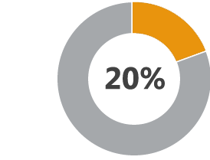
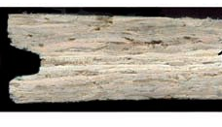
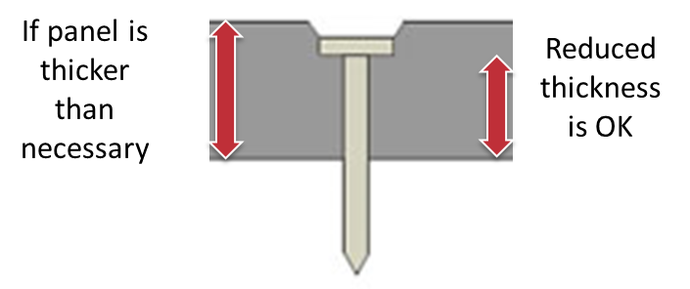
Analysis – Engineered Wood Association (APA)
  Max 1/16"
1. If any of the following are met, then no reduction in shear capacity needs to be taken:
All nails are overdriven into panels by no greater than ¹/₁₆" under dry conditions (moisture content less than 16%)
No more than 20% of the perimeter fasteners are overdriven by no greater than ⅛“
If all perimeter fasteners are overdriven by the same amount and it appears that wetting occurred during construction, fastener embedment may be due to panel swelling in thickness.
If actual panels used in construction are thicker than the required minimum nominal panel thickness upon which the design shear capacity is based, and the overdriving is less than or equal to the difference between the two panel thicknesses.

Slide 13
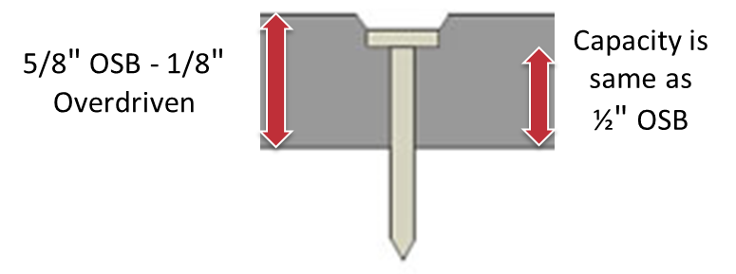
Analysis – Engineered Wood Association (APA)
For example: re‐analyze capacity based on average thickness of panel measured from the bottom of the fastener head.
  i.e. 5/8” panel with fasteners overdriven by 1/8” would have the capacity of ½” panel.
Adjust nailing schedule accordingly.

Slide 14
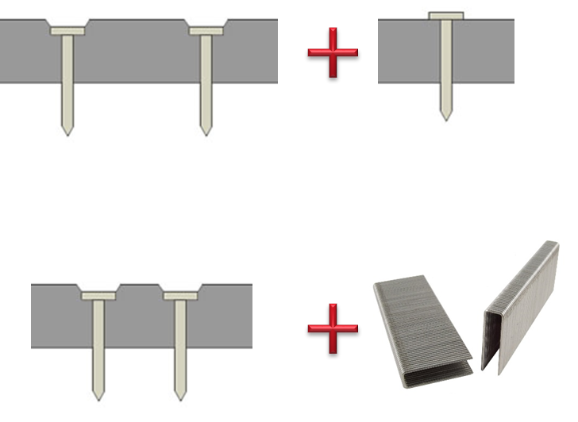
Analysis – Engineered Wood Association (APA)
If any of the following are met, then a reduction in shear capacity needs to be taken:
If > 20% of the fasteners around the perimeter are overdriven by over 1/16”, or if any are overdriven by more than 1/8”:
  Then add 1 additional fastener for every 2 that are overdriven.
If the additional nails violate the minimum spacing requirements (3” o.c. for 2 inch lumber for splitting):
  Use staples for the additional fasteners to reduce the potential for splitting.

Slide 15

Analysis – Timber Engineering Company (TECO)
TECO’s Tech Tip outlines an example of calculating reduction in shear capacity
It also draws attention to other factors that impact shear capacity including:
  Fastener type
  Fastener size
  Fastener spacing
  Amount of penetration into the framing members
  Wood species
  Width of framing members

Slide 16
Analysis – Timber Engineering Company (TECO)
Consider the following example:
  Assume that 20% of the nails in a shear wall are driven flush with the sheathing and the remaining nails are overdriven as follows:
    30% between flush up to ¹/₁₆"
    40% between ¹/₁₆" up to ⅛" and
    10% between ⅛" up to ³/₁₆".

Slide 17
Analysis – Timber Engineering Company (TECO)
Using the chart (on the following slide) an estimate of the reduction in shear capacity based on the number and magnitude of overdriven nails would be:
  20% flush = 0% reduction
  30% up to 1/16” ≈ 2.6% reduction
  40% between 1/16” up to 1/8” ≈ 6.7% reduction
  10% between 1/8” up to 3/16” ≈ 2.5% reduction
Total Reduction ≈ 11.8%

Slide 18
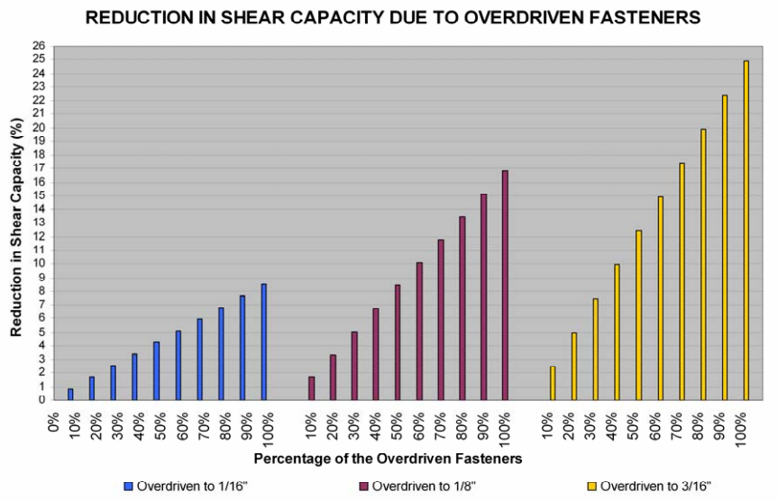
Analysis – Timber Engineering Company (TECO)

Slide 19
Conclusion
When sheathing fasteners are overdriven, the sheathing panel or structure should be evaluated to determine the impact of the overdriven fasteners on the shear performance of the building.
If it is determined that a sufficient number of fasteners are overdriven, corrective action per APA or TECO recommendations should be followed.

Slide 20
References
ANSI/AWC National Design Specification for Wood Construction; American Wood Council; 2015.
APA – Engineered Wood Association, 2011, “Effect of Overdrive Fasteners on Shear Capacity,” TT-012B.
Timber Engineering Company, 2008, “Reduction in Shear Capacity Due to Overdriven Fasteners,” V1.0.
International Building Code, International Code Council; 2015

