Slide 1
Heel Blocking Requirements and Capacity Analysis
Overview
Revised 3/22/2017

Slide 2
SBCA has been the voice of the structural building components industry since 1983, providing educational programs and technical information, disseminating industry news, and facilitating networking opportunities for manufacturers of roof trusses, wall panels and floor trusses. SBCA endeavors to expand component manufacturers’ market share and enhance the professionalism of the component manufacturing industry.
Copyright © 2017 Structural Building Components Association.

Slide 3
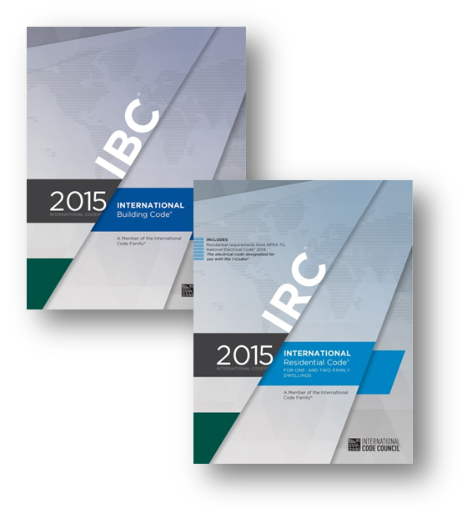
Introduction
Both the International Residential Code (IRC) and the International Building Code (IBC) require that the top plates of exterior braced wall panels be attached to the rafters or roof trusses above.
This connection is only required for designated
exterior braced wall panels, not all exterior walls.

Slide 4
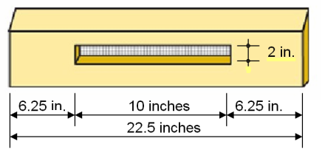
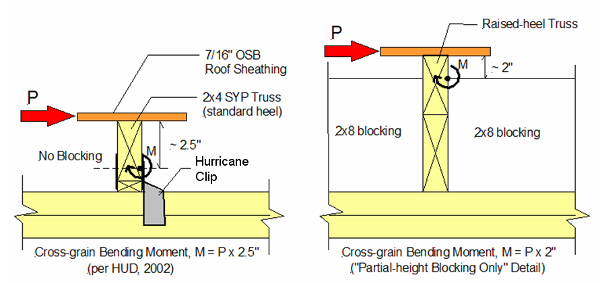
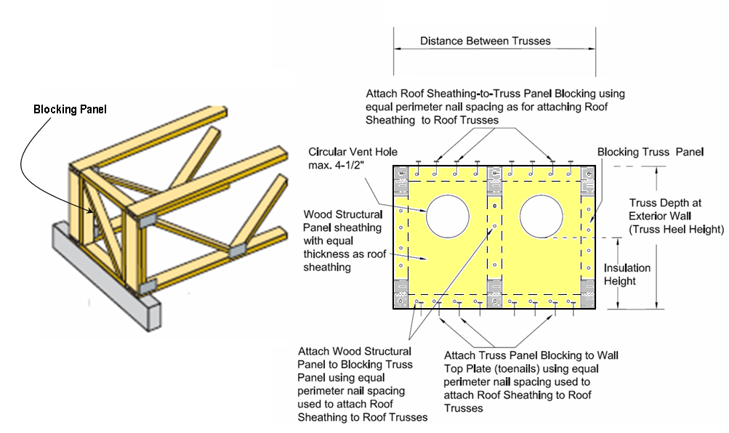
Introduction
This presentation covers code requirements (IRC, IBC) and alternate engineered designs and capacities, including:
  Heel/bird blocking
  Partial height blocking
  Panel blocking

Slide 5
Introduction
Heel blocking is a commonly used method to transfer in-plane lateral loads from the braced wall panel to the roof diaphragm.
Structural engineers may have questions regarding the prescriptive code requirements or the capacity of commonly used heel blocking to achieve a desired load transfer.
In addition there may be questions as to who is responsible for the determining the required strength.

Slide 6
Key Definitions
Braced Wall Line: A straight line through the building plan that represents the location of the lateral resistance provided by the wall bracing.
Braced Wall Panel: A full-height section of wall constructed to resist in-plane shear loads through interaction of framing members, sheathing material and anchors. The panel’s length meets the requirements of its particular bracing method and contributes toward the total amount of bracing required along its braced wall line.
Building Designer: Owner of the building or the person that contracts with the Owner for the design of the Framing Structural System and/or who is responsible for the preparation of the Construction Documents. When mandated by the Legal Requirements, the Building Designer shall be a Registered Design Professional.

Slide 7
Key Definitions
Cross-grain Bending: When a wood member is loaded such that it tends to bend in a direction against or across the grain, it is said to be in cross-grain bending. Wood is weak in bending about this axis.
Diaphragm: A horizontal or nearly horizontal system acting to transmit lateral forces to the vertical resisting elements. Where the term “diaphragm” is used, it includes horizontal bracing systems.
Heel Block/ Bird Block/ E Block: Is a term used for the block installed between roof truss heels at the top of the exterior wall.

Slide 8
Key Definitions
Partial Height Blocking: A heel block that is not the full height of the truss heel is called Partial Height Blocking. The shear transfer capacity of this kind of blocking is less than that of full height blocking, but it provides room for ventilation, insulation, ducts, etc.
Perimeter Blocking: Blocking along the perimeter of the roof diaphragm that has the ability to transfer loads into the side walls or end walls.
Truss Designer: Person responsible for the preparation of the Truss Design Drawings.
Weak-axis Bending: When a structural member is loaded such that it tends to bend about the axis of lower moment of inertia, it is said to be in weak-axis bending. Wood members are especially weak in bending about this axis.

Slide 9
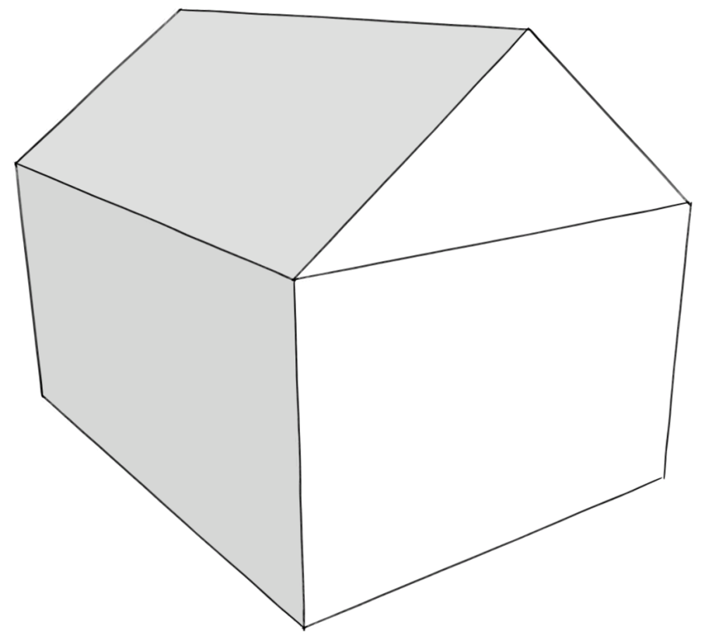
Background
Structures can be designed to take a considerable amount of lateral load from wind or earthquake loading.
These lateral loads in the roof system are transferred through the roof diaphragm, which is the structural plane created by the roof sheathing.
Load

Slide 10
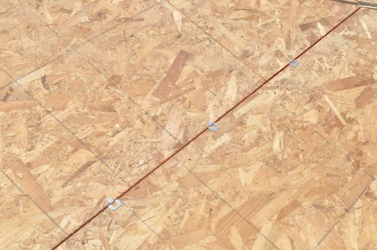
Background
To design the roof diaphragm, building designers determine:
  The thickness and grade of the roof sheathing
  The nail size and frequency
  The size of the supporting framing members
  The amount of blocking required

Slide 11
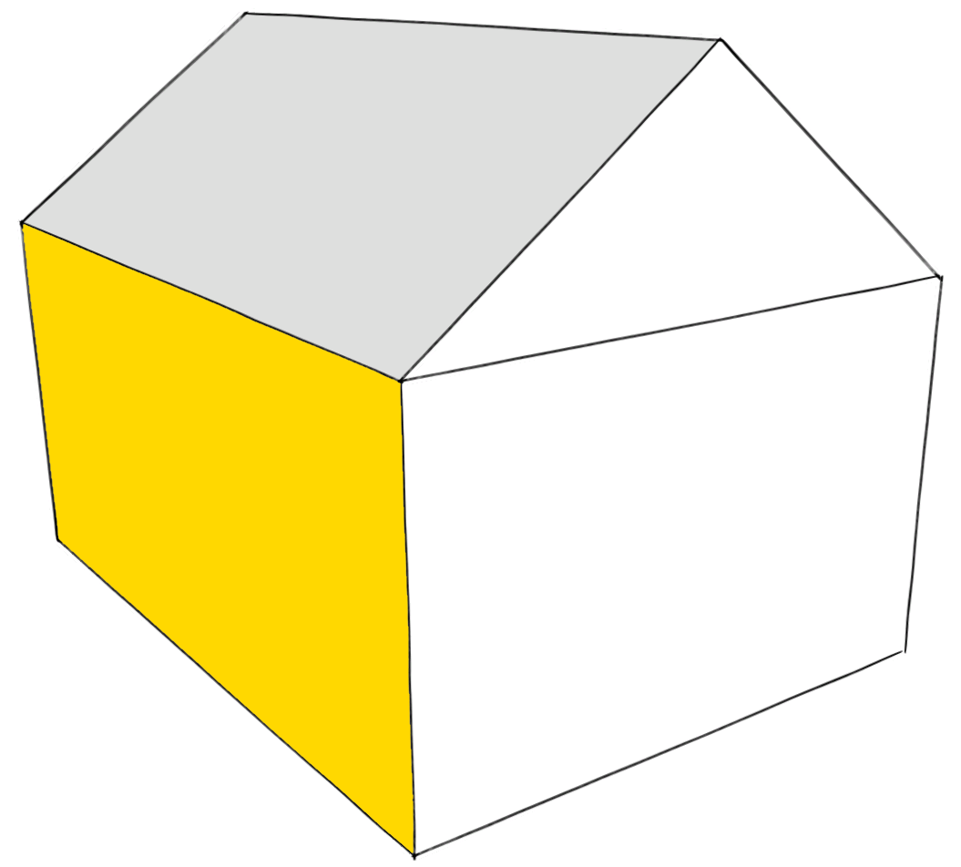
Background
The perimeter of the diaphragm then must have the ability to transfer loads into the side walls, or shear walls.
Shear walls act like a roof diaphragm, only there are installed vertically.
Load

Slide 12
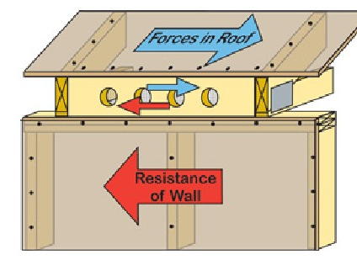
Background
Truss heel blocking can function as perimeter blocking of the roof diaphragm
However, the adequacy of this connection depends on multiple factors
The Building Designer may not assume that prescriptive heel blocking will perform adequately as perimeter blocking for the roof diaphragm

Slide 13
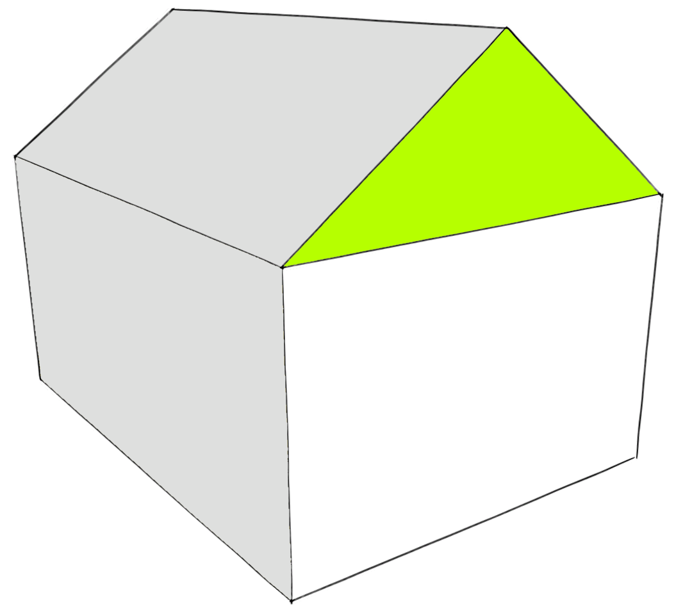
Designer Responsibility
The Truss Designer assumes that the truss will carry only in-plane loads and designs the truss accordingly
The Building Designer is responsible for designing the system as a whole to resist loads not in-plane with the truss, including lateral loads and rotation

Slide 14
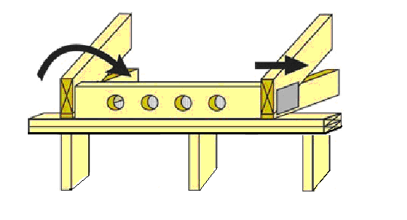
Designer Responsibility
The IRC requires blocking at the truss heels where there is a greater expectation of lateral loads causing rotation and displacement.
Blocking is not typically installed in most interior parts of the country because the truss-to-bearing connections and the relatively close roof sheathing attachment is assumed to be sufficient to prevent any movement.

Slide 15
Designer Responsibility
A few other considerations:
  Blocks may not have to go the full height of the truss heel to effectively block it and keep it from rotating
  A block may not be required in every space between trusses.
  Ventilation requirements may need more area than a partial height block can supply.

Slide 16
Building Code Requirements – IRC 2015
IRC 2015 contains general code requirements for bracing (lateral support) of trusses
These requirements are specifically to resist rotation and do not address the transfer of wind or seismic forces.
R802.10.3 Bracing (Roof)
R502.11.2 Bracing (Floor)

Slide 17
Building Code Requirements – IRC 2015
IRC 2015 also provides prescriptive guidance for the roof diaphragm to shear wall connections
Connections are primarily determined by:
  Seismic zone
  Distance from the roof sheathing to the top of the braced wall panel plate
R602.10.8.2 Connections to roof framing.

Slide 18
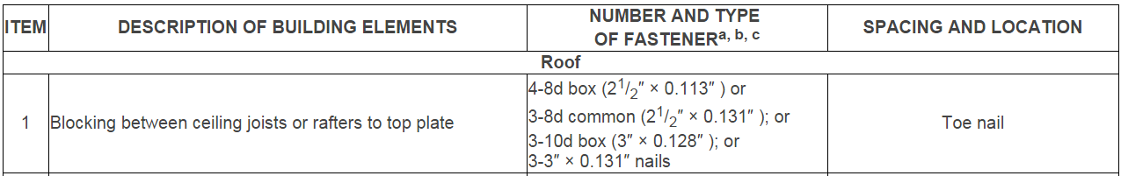
Building Code Requirements - IRC
Fastening of blocking to the top plate is to be in accordance with Table R602.3(1) [item 1]

Slide 19
Building Code Requirements - IRC
< 9¼”
No blocking required
For Seismic Design Categories A, B, and C:
  Braced Wall to Roof Truss Distance 9¼” or less
    Blocking is not required

Slide 20
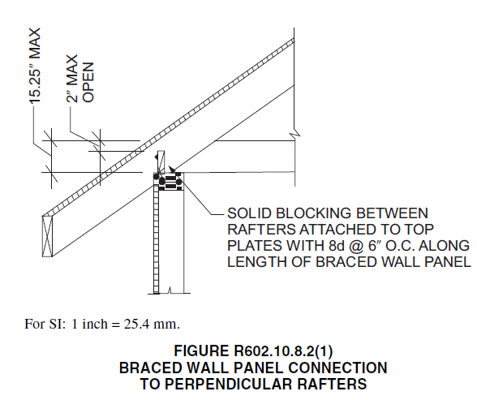
Building Code Requirements - IRC
For Seismic Design Categories A, B, and C:
  Braced Wall to Roof Truss Distance between 9¼” and 15¼”
    Blocking according to Figure R602.10.8.2(1) is required.

Slide 21
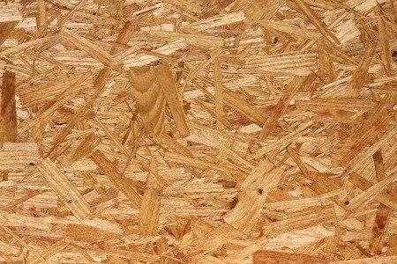
Building Code Requirements - IRC
For Seismic Design Categories A, B, and C:
  An exception allows wood structural panels to extend above the top plate where the outside edge of the truss aligns with the outside face of the wall .

Slide 22
Building Code Requirements - IRC
For Seismic Design Categories D₀, D₁
  Braced Wall to Roof Truss Distance 15¼” or less
    Blocking according to Figure R602.10.8.2(1) is required.

Slide 23
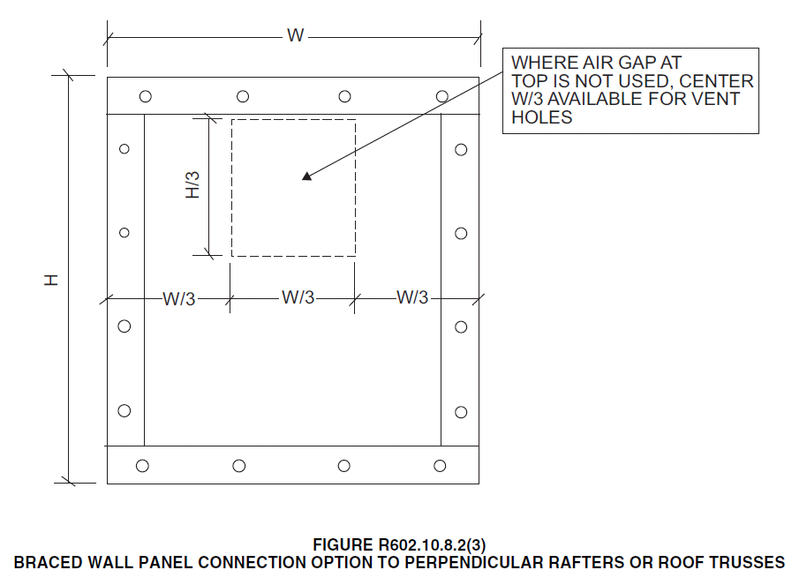
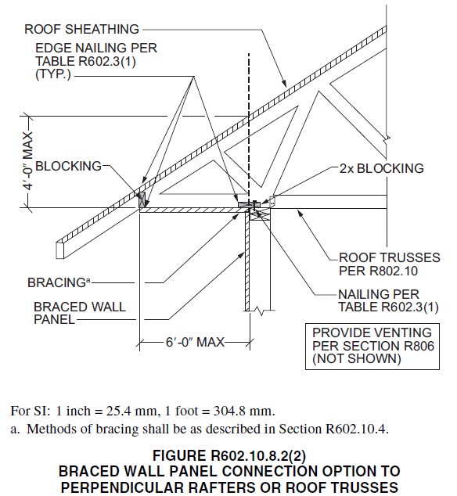
Building Code Requirements - IRC
For all Seismic Design Categories:
  Braced Wall to Roof Truss Distance greater than 15¼”
    Blocking according to Figure R602.10.8.2(2) or R602.10.8.2(3) is required

Slide 24
Building Code Requirements - IRC
Seismic Design Category | Braced Wall to Roof Truss Distance |  |  | Engineered Design Allowed
 | ≤ 9¹/₄” | > 9¹/₄” & ≤ 15¹/₄” | > 15¹/₄”
A, B, C | None | R602.10.8.2(1) | R602.10.8.2(2) or (3) | Yes
D₀, D₁ | R602.10.8.2(1) | R602.10.8.2(1) | R602.10.8.2(2) or (3) | Yes

Slide 25
Building Code Requirements - IBC
For design of wood-frame diaphragms, the IBC directs one to AWC SDPWS (Section 2306.2).
2308.6.7 Connections of braced wall panels.
2308.6.7.2 Top plate connection.

Slide 26
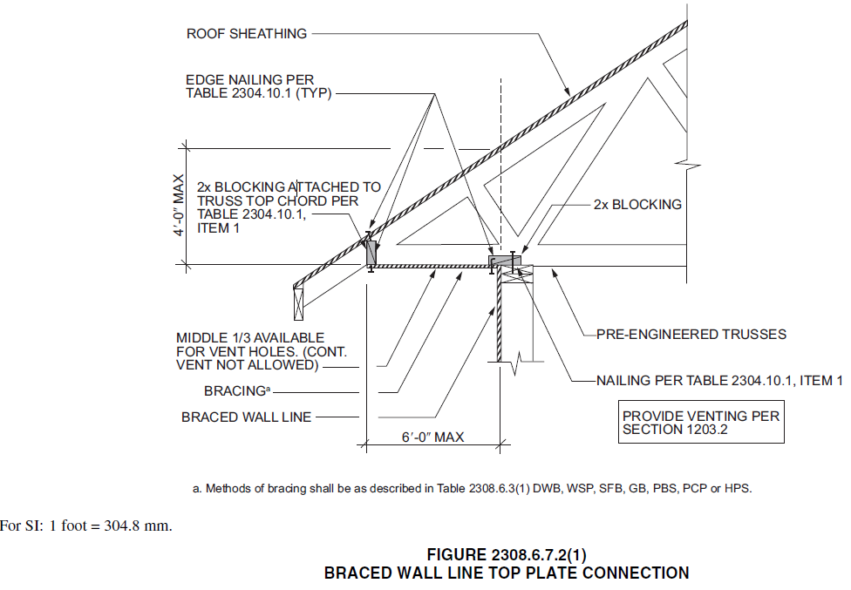
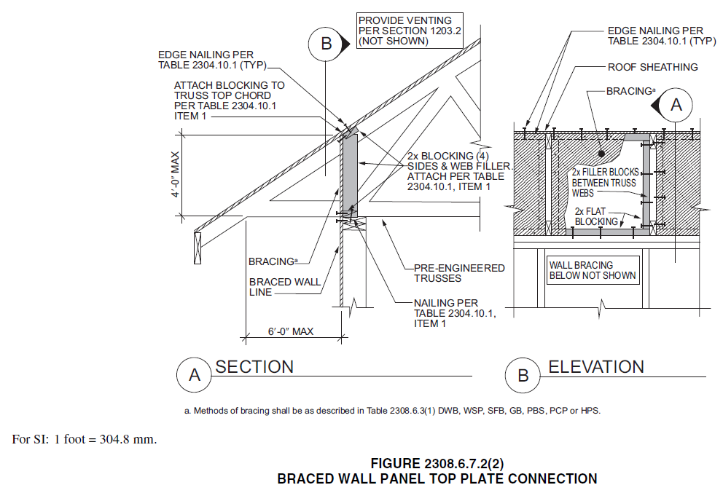
Building Code Requirements - IBC
For conventional light-frame construction the IBC includes different requirements than in the IRC

Slide 27
Engineered Design – Bird Blocking
Bird blocking is another method of transferring lateral loads from the roof diaphragm to the shear walls.
The block is installed between roof truss heels at the top of the exterior wall to carry and transfer lateral forces from the roof diaphragm to the braced wall.
Blocks with ventilation holes typically have wire mesh on one side to prevent animals from entering the attic space.

Slide 28
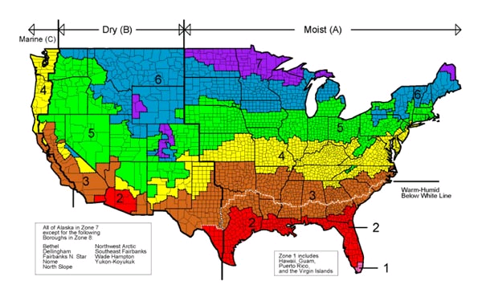
Engineered Design – Bird Blocking Example
Note that IRC energy/ventilation requirements in IRC R806.2 and R806.3 need to be met.
Attics or roofs can be designed and constructed to be either vented or un-vented in any hygro-thermal zone
The choice of venting or not venting is a design and construction choice and not a requirement determined by the physics or by the building codes.

Slide 29
Engineered Design – Bird Blocking
Even a block with holes or slots cut into it can provide significant capacity for resisting these loads
The capacity of a bird block depends on:
  The adjusted shear design value parallel to grain (horizontal shear) of the lumber
  The amount of material removed to create the ventilation holes

Slide 30
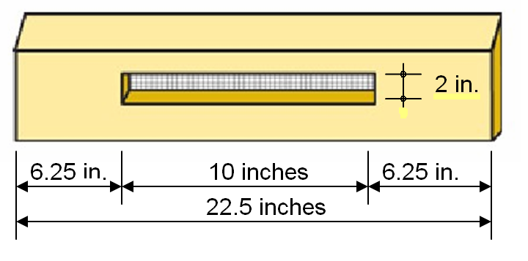
Engineered Design – Bird Blocking Example
Given:
  The truss manufacturer uses 2”x6” beveled blocks with a 2x10 letterbox type ventilation hole as shown

Slide 31
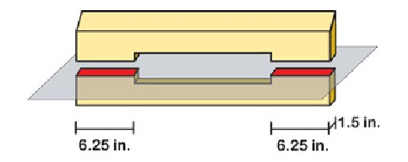
Engineered Design – Bird Blocking Example
Imagine a horizontal plane cutting through the block at the location with the least material.
In this case it’s a total of 18.75 sq. in.

Slide 32
Engineered Design – Bird Blocking Example
This is the area of block left to resist the shear forces being transferred from the roof diaphragm to the wall below.
To be conservative, we will use a value of F_{v} = 110 psi which is for “Northern Species”

Slide 33
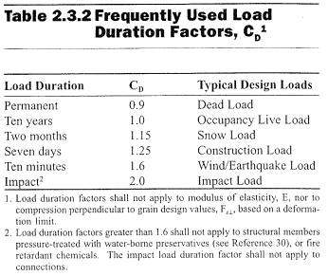
Engineered Design – Bird Blocking Example
The only adjustment factor to consider is load duration factor (Table 2.3.2 of the NDS).
We will use 1.6, since these forces are either caused by wind or seismic events.

Slide 34
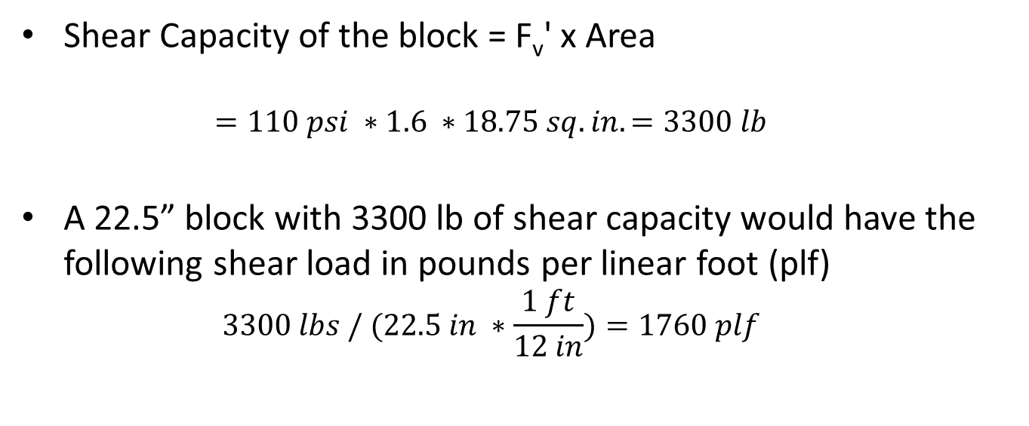
Engineered Design – Bird Blocking Example
Shear Capacity of the block = F_{v}' x Area
  $$=110 psi ∗1.6 ∗18.75 sq. in. =3300 lb$$
A 22.5” block with 3300 lb of shear capacity would have the following shear load in pounds per linear foot (plf)
  $$3300 lbs / (22.5 in ∗\frac{1 ft}{12 in})=1760 plf$$

Slide 35
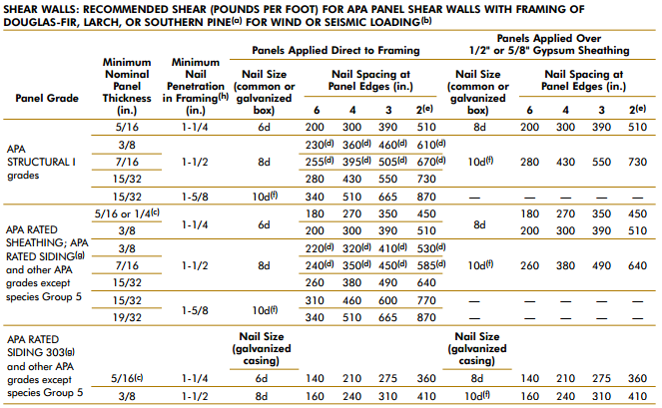
Engineered Design – Bird Blocking Example
According to the APA’s Introduction to Lateral Design, the highest recommended load listed is 820 plf for roof diaphragms and 870 plf for shear walls.
Therefore, even a low grade “bird block” with a large horizontal ventilation opening is adequate, provided the building designer properly details the roof-to-block and the block-to-wall connections.

Slide 36
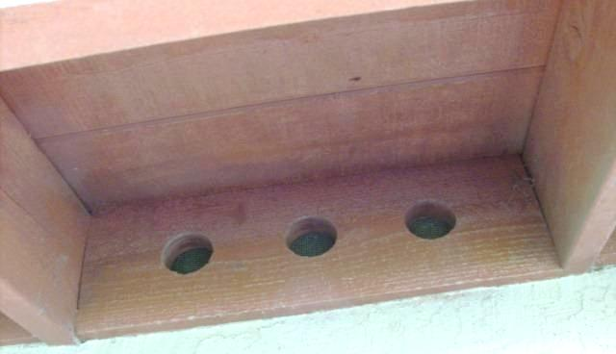
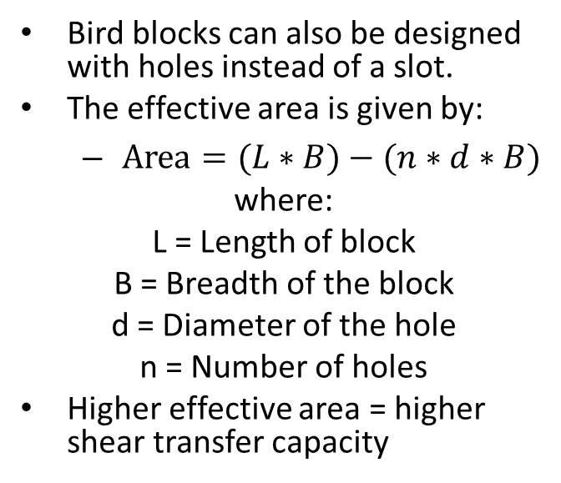
Engineered Design – Bird Blocking Example
Bird blocks can also be designed with holes instead of a slot.
The effective area is given by:
  $Area=(L∗B)−(n∗d∗B)$
where:
L = Length of block
B = Breadth of the block
d = Diameter of the hole
n = Number of holes
Higher effective area = higher shear transfer capacity

Slide 37
Engineered Design – Partial Height Blocking
Partial Height blocking is illustrated in the IRC.
In some cases it may be used to leave room for insulation baffles.
Per IRC R806.3, a minimum of 1” space must be provided between insulation and the roof sheathing at the location of the vent.

Slide 38
Engineered Design – Partial Height Blocking
The use of Partial Height Blocking relies on both weak-axis bending and cross-grain bending of the top chord member of trusses to transfer lateral forces from the roof diaphragm to the wall below.
Section 3.8.2 of the NDS recommends avoiding “designs that induce stress perpendicular to grain”.

Slide 39
Engineered Design – Partial Height Blocking
HUD tested lateral force transfer from roof diaphragm system to braced walls.
The absence of failure of the top chord due to cross-grain bending indicated yielding and ductile overall response.
The tests used no blocking, and are therefore conservative compared with a raised-heel truss with Partial Height Blocking.

Slide 40
Engineered Design – Partial Height Blocking
Testing yielded a maximum lateral force transfer of about 570 lb/truss.
Applying a safety factor of 2.5 results in a design value of 228 lb/truss for in-plane shear transfer for the “Partial Height Blocking only” detail.
With trusses spaced 24” o.c., the design unit shear in the roof diaphragm will be 114 plf.

Slide 41
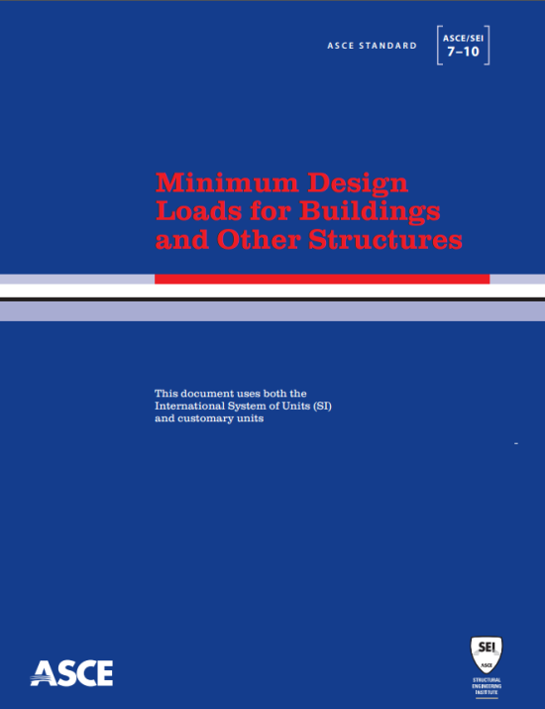
Engineered Design – Partial Height Blocking
A span limit for roof diaphragm systems with partial-height blocking only can be determined per IBC Simplified Method / ASCE 7-10 Section 12.14 Simplified Method

Slide 42
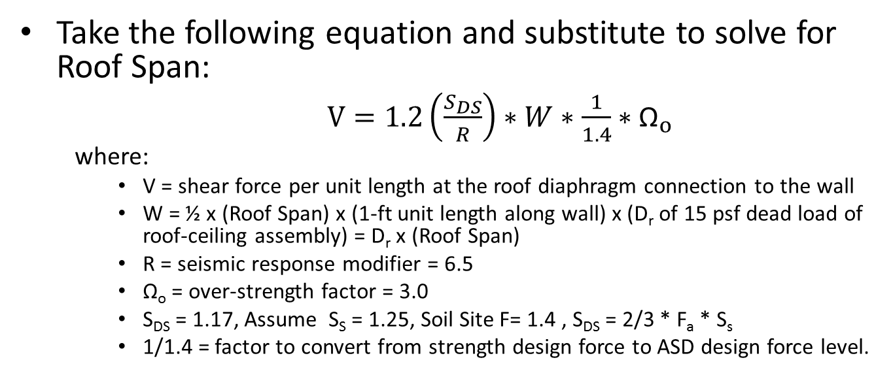
Engineered Design – Partial Height Blocking
Take the following equation and substitute to solve for Roof Span:
    $V=1.2\left(\frac{S_{DS}}{R}\right)∗W∗\frac{1}{1.4}∗{\text{Ω}}_{o}$
  where:
    V = shear force per unit length at the roof diaphragm connection to the wall
    W = ½ x (Roof Span) x (1-ft unit length along wall) x (D_{r} of 15 psf dead load of roof-ceiling assembly) = D_{r} x (Roof Span)
    R = seismic response modifier = 6.5
    Ω_{o} = over-strength factor = 3.0
    S_{DS} = 1.17, Assume S_{S} = 1.25, Soil Site F= 1.4 , S_{DS} = 2/3 * F_{a} * S_{s}
    1/1.4 = factor to convert from strength design force to ASD design force level.

Slide 43
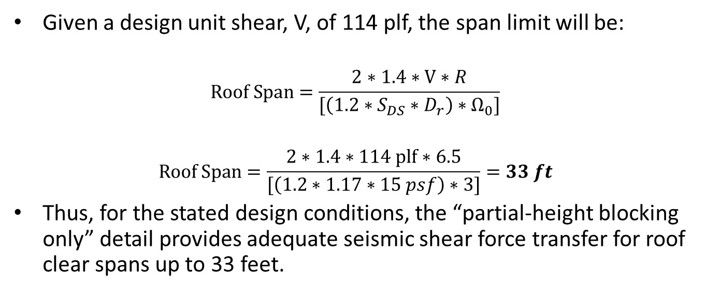
Engineered Design – Partial Height Blocking
Given a design unit shear, V, of 114 plf, the span limit will be:
$$Roof Span=\frac{2∗1.4∗V∗R}{[\left(1.2∗S_{DS}∗D_{r}\right)∗{\text{Ω}}_{0}]}$$
$$Roof Span=\frac{2∗1.4∗114 plf∗6.5}{[\left(1.2∗1.17∗15 psf\right)∗3]}=33 ft$$
Thus, for the stated design conditions, the “partial-height blocking only” detail provides adequate seismic shear force transfer for roof clear spans up to 33 feet.

Slide 44
Engineered Design – Partial Height Blocking
A similar equation can be developed for transfer of shear forces due to wind acting on the gable end of a roof.
  Analysis indicates that for a 120 mph Exposure B condition, the roof span should be limited to 28 feet for 12:12 gable roof pitch or 52 feet for a 6:12 gable roof pitch or less
    For gable roof pitches in between 12:12 and 6:12, the roof span limit can be scaled by interpolation (e.g., span limit of 40 feet for 9:12 gable roof pitch).
For hipped roofs, the span limits for wind should not control over seismic.

Slide 45
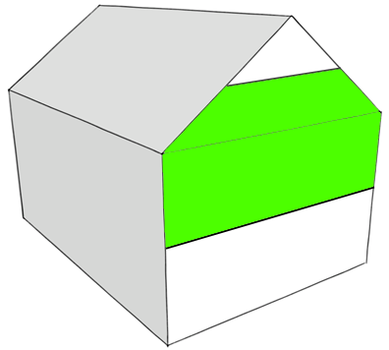
Engineered Design – Partial Height Blocking
This analysis is based on ASCE 7-10 wind loads with the assumption that the length of the roof is at least equal to the span of the roof
Gable end tributary area is equal to one-half the story height of 8 feet plus one-half the gable end area above the supporting end walls.
Length
Span
Side Wall
Tributary Area

Slide 46
Engineered Design – Partial Height Blocking
For special conditions requiring an even greater amount of force transfer than can be provided by the “partial-height blocking only” detail (114 plf) the following options should be considered:
  Provide additional full-height blocking in the eave overhang.
  Use approved proprietary connection hardware in place of or in addition to Partial Height Blocking.

Slide 47
Engineered Design – Engineered Panel Blocking
Another option Building Designers may specify for high heel or flat truss applications is a blocking panel.
Truss manufacturers can provide these as long as they have enough information to complete the design (the shear load).

Slide 48
Engineered Design – Engineered Panel Blocking
Benefits of panel blocking:
  Lateral loads are easily resisted
  Structural component that has solid design values
  The component manufacturer can reuse material that might otherwise go to waste

Slide 49
Conclusion
A heel block or “bird block” with a large horizontal ventilation opening can more than suffice as perimeter blocking, provided the building designer properly details the roof-to-block and the block-to-wall connections.
Partial Height Blocking can be used as long as it is able to achieve sufficient shear transfer.
  If insufficient, either full height blocking at the wall or full height blocking in the eave overhang should be considered.
  Alternatively, approved proprietary connection hardware in place of or in addition to Partial Height Blocking should be used.
The Building Designer must be aware that the lateral load capacity will also be limited by the capacity of the roof sheathing (diaphragm).
Lateral load capacity of the roof sheathing will be reduced due to insufficient perimeter nailing caused by the absence of blocking as a nailing surface.

Slide 50
References
Anderson, C.A., Woeste, F.E. and Loferski, J.R. 2003; Manual for the Inspection of Residential Wood Decks and Balconies; Forest Products Society, 2801 Marshall Ct., Madison, WI 53705.
ANSI/AWC NDS-2012, ASD/LRFD NDS; National Design Specification for Wood Construction. 2012; American Wood Council, 222 Catoctin Circle, SE, Suite 201, Leesburg, VA 20175.
Carradine, D.M., Bender, D., Loferski, J.R. and Woeste, F.E. 2005; Residential Deck Ledger Design; Building Safety Journal, December, 2005: (4-7).
Carradine, D.M., Bender, D., Loferski, J.R. and Woeste, F.E. 2006; Residential Deck Ledger Connection Testing and Design; Structure Magazine, May, 2008: (53-56).
Design for Code Acceptance, DCA 6, Prescriptive Residential Wood Deck Construction Guide; 2009; American Wood Council, 222 Catoctin Circle, SE, Suite 201, Leesburg, VA 20175.
Loferski, J.R., Woeste, F.E., Caudill, R., Platt, T. and Smith, Q. 2004; Load-Tested Deck Ledger Connections; Journal of Light Construction. 22(6):71-78.
Woeste, F.E. 2008; Safe and Durable Coastal Decks; Coastal Contractor, March/April, 2008: (1-7).

