Slide 1
Inspection and Quality Assurance Requirements for Metal Plate Connected Wood Trusses
Educational Overview

Slide 2
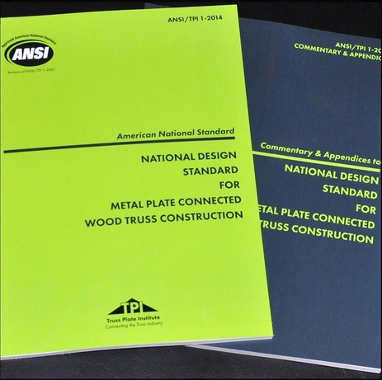
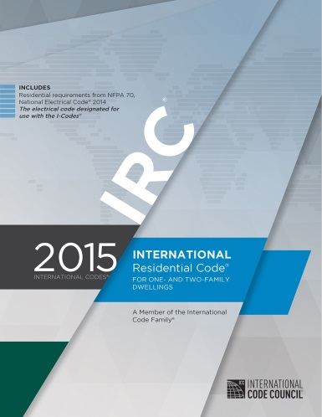
Introduction
What do the codes say about requirements for inspection and quality assurance of trusses?
The answer can be found in:
International Building Code (IBC) Chapters 1 and 17
International Residential Code (IRC) Chapter 1
ANSI/TPI 1 Chapters 2 and 3

Slide 3
Code Requirements
However, there is often confusion about truss inspection requirements
Inspection requirements are scattered throughout the codes
Definitions and terminology are unfamiliar to most people

Slide 4
Code Requirements
Short answer:
Is truss manufacturing subject to Chapter 17 requirements for Special Inspections? NO
Does the third party inspection process satisfy code requirements? YES

Slide 5
Key Definitions
Building Code – As It Applies To A Building, Any Set Of Standards Set Forth And Enforced By A Jurisdiction For The Protection Of Public Safety.
Building Official – Officer Or Other Designated Authority Charged With The Administration And Enforcement Of The Building Code, Or A Duly Authorized Representative.
Building Permit – Certificate Of Permission Issued By A Jurisdiction To An Owner To Construct, Enlarge, Or Alter A Building.
Construction Documents – Written, Graphic And Pictorial Documents Prepared Or Assembled For Describing The Design, Location And Physical Characteristics Of The Elements Of A Project Necessary For Obtaining A Building Permit.
Jurisdiction – Governmental Unit That Has Adopted This Code Under Due Legislative Authority.
Registered Design Professional (RDP) – An individual who is registered or licensed to practice their respective design profession as defined by the statutory requirements of the professional registration laws of the state or jurisdiction in which the project is to be constructed.

Slide 6
Key Definitions
Special Inspection – Inspection of construction requiring the expertise of an approved special inspector in order to ensure compliance with this code and the approved construction documents.
Structural Element – Single structural member (other than a Truss) that is specified in the Construction Documents.
Structural Observation – The visual observation of the structural system by a registered design professional for general conformance to the approved construction documents.
Truss – Individual metal-plate-connected wood component manufactured for the construction of a Building.
Truss Manufacturer – Person engaged in the fabrication of Trusses.

Slide 7
IBC and IRC Chapter 1
Contains general provisions for:
Submission of construction documents
Approval of the documents by the building official
General building inspection requirements

Slide 8
IBC Chapter 17
Special Inspections
Where required, are in addition to inspections required by Chapter 1
Performed by approved agencies
Special Inspectors have expertise in a field of knowledge that the building official may not
May or may not be registered design professionals

Slide 9
IBC Chapter 17
Structural Observations
May also be required in addition to Special Inspections
Performed by registered design professionals
Generally reserved for building systems resisting high seismic and high wind forces

Slide 10
ANSI TPI 1
Standard is referenced by the codes
Addresses requirements for the design and manufacture of MPCWT
Includes provisions for inspection and quality assurance

Slide 11
IBC and IRC Chapter 1
The Building Official is responsible for all the required inspections of Buildings, which includes the structural framing (and the trusses that comprise it)
This role can be delegated to approved agencies or individuals.
IBC 104.4 Inspections.
IRC R104.4 Inspections.

Slide 12
IBC and IRC Chapter 1
The entire inspection process for metal plate connected wood trusses is outlined in IBC Section 110 and IRC Section 109 where it is stated that framing inspections are to be performed by the Building Official.
If the Trusses are manufactured in a manufacturing facility, the inspection process needs to be performed by an approved inspection agency.
IRC R109.1 Types of inspections.
IRC R109.1.4 Frame and masonry inspection.
IRC R109.2 Inspection agencies.

Slide 13
IBC Chapter 17 – Special Inspections and Structural Observations
IBC Chapter 17 defines when special inspections are required, and what items are included in the special inspection provisions.
MPCWT do not require special inspections, UNLESS they are greater than 60 foot span.
1705.5.2 Metal-plate-connected wood trusses spanning 60 feet or greater.

Slide 14
IBC Chapter 17 – Special Inspections and Structural Observations
Special inspections are intended for:
Special occupancies
Circumstances with critical seismic and wind conditions
Where a Structural Element is deemed critical from a life safety perspective
IBC 1704.6 Structural observations.
IBC 1704.6.1 Structural observations for seismic resistance.
IBC 1704.6.2 Structural observations for wind requirements.

Slide 15
IBC Chapter 17 – Special Inspections and Structural Observations
Section 1704 does not require special inspections for MPCWT
Furthermore, 1704.2 lists an exception for conventional light-frame construction, which would include the majority of construction using MPCWT and other components.
IBC 1704.2 Special inspections.

Slide 16
IBC Chapter 17 – Special Inspections and Structural Observations
ANSI/TPI 1 includes provisions that are upheld under the supervision of a third party quality control agency.
The third party QC process that many Truss Manufacturers employ is done at the manufacturing facility and takes the place of any special inspection requirements.
IBC 1704.2.5.1 Fabricator approval

Slide 17
ANSI/TPI 1
The Building Codes reference ANSI-based consensus codes and standards to provide specific information that would be unwieldy to include in the codes themselves.
The codes state in several locations that the design and manufacture of metal plate connected wood trusses shall comply with ANSI/TPI 1.

Slide 18
ANSI/TPI 1
ANSI/TPI 1 in-plant inspection process was clarified in the 2014 edition, and is referenced by the 2015 editions of both the IBC and IRC.
ANSI/TPI 1-2014 Chapter 3 (Quality Criteria for the Manufacture of Metal-Plate-Connected Wood Trusses) implements the in‑plant quality control process.
ANSI/TPI 1-2014
Section 2.3.6.11 In-Plant Truss Inspections.
Section 3.1 GENERAL
Section 3.2 IN-PLANT QUALITY ASSURANCE

Slide 19
Closing Thoughts
The traditional third party inspection process satisfies IBC and IRC requirements for metal plate connected wood trusses
Truss manufacturing:
Must conform to ANSI/TPI 1, which follows IBC and IRC requirements for regular third party inspections to evaluate compliance
Does not fall under the IBC Chapter 17 definition of “Fabricated Item”
Thus, there is no requirement to have an on-site “special inspection” of the Trusses

